Slide 1
Representing Expert System and Using Domain Knowledge
Artificial Intelligence

Slide 2
EXPERT SYSTEMS
Solve problems normally solved by human experts.
Modeling computers to do specific tasks in the same way human experts do.
Highly domain specific.
Eg. Expert Systems built for diagnosis of diseases will only do that task.

Slide 3
Architecture of expert system
USER
USER INTERFACE
Facts,queries
Advice, consultation and justification
KNOWLEDGE BASE
INFERENCE ENGINE
Architecture of the Expert System

Slide 4
User interface
Allows user to enter rules and facts about a particular situation and ask questions to the system.
Provide responses to user requests.
Supports all other communication between system and user.
Knowledge base
Developed by experts in the area.
Data in the form of rules.
Is updated regularly so that system provides most relevant and complete assistance to the user – knowledge acquisition module.
Inference Engine
Uses rules provided by Knowledge base and the user to infer new facts.

Slide 5
Representing and Using Domain Knowledge
MYCIN
RI(XCON)
PROSPECTOR
DESIGN ADVISOR

Slide 6
Most widely used way for representing knowledge : Set of production rules of the form if-then.
MYCIN is an example for expert system, since it performs a task normally done by human experts.
MYCIN attempts to recommend appropriate therapies for patients with bacterial infections.
MYCIN represents most of its diagnostic knowledge as a set of rules.

Slide 7
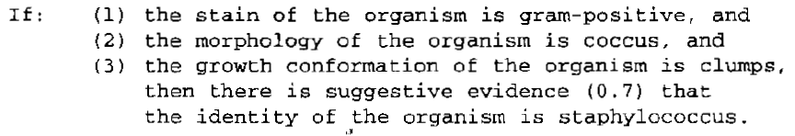
A typical MYCIN rule looks like:
Rule has a certainty factor associated with it, which is a measure of the extent to which the evidence that is described by the antecedent of the rule supports the conclusion that is given in the rule’s consequent.
Certainty factor has a value between 0 and 1.
Rules are written in LISP language.
Once the identity of organism causing disease is revealed, it then attempts to select a therapy by which the disease can be treated.

Slide 8
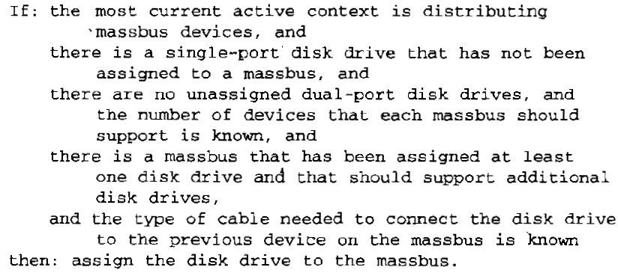
R1 (also called XCON) is an example for expert system used in the design domain.
Used to select the computer system components based on the customer's requirements.
It is a program that configures VAX systems.
Rules of RI look like:
Unlike MYCIN, there is no measure of certainty in rules of RI
i.e. it is possible to state exactly what it has to do for each situation.

Slide 9

PROSPECTOR is expert system that provides advice on mineral exploration.
Its rule looks like :
Here, each rule contains two confidence estimates.
The first estimate indicates the extent to which the presence of evidence described in the condition part of rule suggests the validity of rule’s conclusion.
The second estimate indicates the extent to which the lack of evidence indicates that the conclusion is not valid.
The no: 2 indicates the presence of evidence is mildly encouraging. And no:-4 indicates the absence of evidence is strongly discouraging for conclusion.

Slide 10
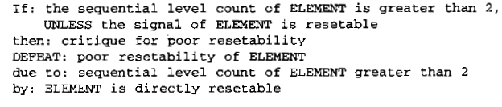
DESIGN ADVISOR is an expert system that critics chip designs.
Its rule looks like :
This system gives advice to chip designer, who can accept or reject the advice.
The system exploits a justification-based truth maintenance.

Slide 11
Reasoning with the Knowledge
Expert System represent knowledge in a rule format. Hence also known as Rule-Based Expert System.
Some reasoning mechanisms: Forward chaining, backward chaining, or some combination of both, is usually used.
For eg: MYCIN uses backward chaining to discover what organisms are present, then it uses forward chaining to reason from organisms a treatment strategy.
R1 system used forward chaining.
Other reasoning mechanisms are also used.
Eg : DESIGN ADVISOR system uses justification-based truth maintenance system.

